Slide 1
OMG Threat Model Update
Gerald Beuchelt

Slide 2
Status
Core group actively working on developing a model
Weekly status update meetings
Regular working/modeling sessions
Using GitHub as a repository for artifacts: https://github.com/omg-threat-modeling/phase1
Current focus
Abstract STIX concepts like indicators, kill chain, threat actor to cover non-cyber domains
Analyze and refine business processes for actors
Identify and vet specific use cases

Slide 3
Model for Semantic Interoperability No Common Meta Model
PT XML (notional)
Cap XML
Physical Threat Model
CAP (Model)
IODef (model)
Snort (model)
IODef (protocol)
STIX PIM
Snort rules
STIX XML
N*(N-1) ~ O(n^2) mappings
STIX JSON

Slide 4
Model for Semantic Interoperability Common Meta Model
Meta Model/Ontology
STIX RIM
IODef (model, implicit)
CAP (Model, implicit)
STIX XML
STIX JSON
IODef (protocol)
Cap XML
Snort (model, implicit)
Snort rules
Physical Threat Model
PT XML (notional)
N ~ O(n) mappings
Managed by OMG
Managed by Communities

Slide 5
Cross-Protocol/Domain Meta Model
Benefits
Reduce number of point-to-point interoperability connections; reduce interoperability from N² to linear problem
Enable uniform semantic interoperability
Communities continue driving development of specific threat models
Disadvantages
Translations will be lossy
Communities need focus to define mappings from specific model to meta model

Slide 6
Modeling Approach
Start with UML representation of STIX concepts
Remove XML artifcats
Clean up model
Generalize concepts
Extend model to cover additional concepts/broaden scope
Informed by (i.e. mappable to) NIEM models and concepts, but distinctly different
Import additional concepts from other models, if needed

Slide 7
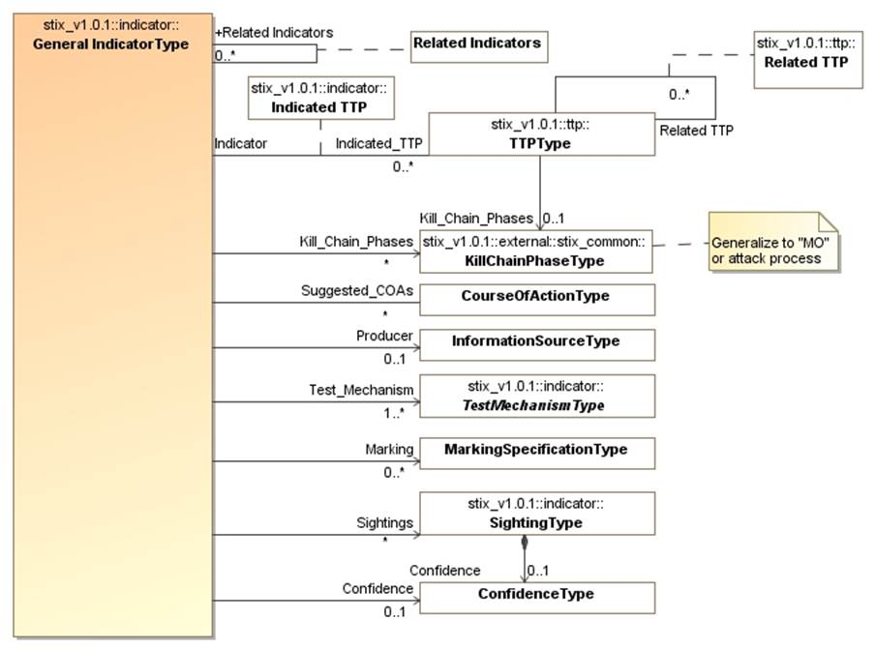
Example: Indicator

Slide 8
Attackers
Defenders
Defense
Capability (TTP)
Informs understanding of
Attack Capability (TTP)
Attack Plan/MO
Course of action
Campaign
Incident
Defense
Plan (MO)
Strategy/Goal
Act
Acts on
Indicator
Bad Actor
Defense Strategy
Good Actor
Target
Observable

Slide 9
High-Level Business Processes

Slide 10
Threat Actor Process

Slide 11
Defender Process

Slide 12
Information Sharing Process

Slide 13
Use Case: Large Company
Company with multiple datacenters, office facilities, international business activity
Large number of deployed security systems, sensors
Firewalls, IDS/IPS, SIEM, monitoring systems, notification/alerting, etc.
Uses FW/Snort rules, STIX/TAXII, IODef, alarms for fire and intrusions, etc.
Physical and information security staff, some 24/7
Interoperable (but not uniform) threat monitoring and assessment

Slide 14
Use Case – Critical Infrastructure
Target: A group of organizations that collaboratively manage critical infrastructure and utilize Industrial Control Systems.
Power, water and other critical infrastructure are threatened by cyber and physical terrorism.
Industrial Control Systems are increasingly computer controlled and connected (directly or indirectly) to the internet and may embed compromised control hardware/software from questionable sources.
Add CA power station attack

Slide 15
Backup

Slide 16
Use Case: Large Company
Scenario 1a: External attack
TTPs: Spearphishing, stolen mobile devices, stolen hard tokens/credentials, office break-in, APT deployment, DDoS attacks
Goals:
Financial gain: identity theft, credit card fraud, stock market manipulation, extortion
Main target/concerns: systems
Systems involved: email/communications, end-user devices, physical locations, various security systems

Slide 17
Use Case: Large Company
Scenario 1b: External attack
TTPs: Spearphishing, stolen mobile devices, stolen hard tokens/credentials, office break-in, APT deployment, DDoS attacks
Goals:
Competitive advantage: stock market manipulation, reputation loss, poach on employee talent base, industrial espionage/intellectual property theft
Main target/concern: humans
Systems involved: email/communications, end-user devices, physical locations, various security systems

Slide 18
Use Case: Large Company
Scenario 2a: Insider threat
TTPs: Malicious activity (including disabling security systems, data exfiltration, data manipulation, backdoors/forged credentials, etc.), APT deployment, physical attack
Goals:
Financial gain: credit card fraud, identity theft, intellectual property theft, asset theft, industrial espionage, extortion
Main target/concerns: humans
Systems involved: servers and end-user devices, various security systems, physical security systems

Slide 19
Use Case: Large Company
Scenario 2b: Insider threat
TTPs: Malicious activity (including disabling security systems, data exfiltration, data manipulation, backdoors/forged credentials, etc.), APT deployment, physical attack
Goals:
Retaliation: attack on service availability, identity theft, reputation loss, physical damage and personal harm
Main target/concerns: humans and organizations
Systems involved: servers and end-user devices, various security systems, physical security systems

Slide 20
Use Case: Large Company
Scenario 2c: Insider threat
TTPs: Malicious activity (including disabling security systems, data exfiltration, data manipulation, backdoors/forged credentials, etc.), APT deployment, physical attack
Goals:
Espionage: intellectual property theft, industrial espionage
Main target/concern: humans and organizations
Systems involved: servers and end-user devices, paper files, various security systems, physical security systems

Slide 21
Use Case – Critical Infrastructure
Scenario 1 – North-East U.S. Power Grid attack by terrorists
An undetected and formerly unknown virus is planted in control systems emergency response software.
A physical attack on a substation initiates a cascading failure
Compromised control systems do not take substations and generating capacity off-line and introduce failure protocols, causing substantial failure of the physical infrastructure
Much of the power grid off-line for months

Slide 22
Use Case – Critical Infrastructure
Scenario 1 – Mitigations
Information from Control Systems, Field Monitors, Physical Security and User reports are integrated via a threat management console
Initial attack is recognized
Initial Cascade is recognized
Failure of control software generates incorrect action, which is recognized as an additional threat
Integrated threat management creates alert, manual control over infrastructure prevents widespread failure

